Slide 1
QuizMaster
By: Null Pointers
(Shailen, Dev, Gautam, Parth)

Slide 2
Purpose
QuizMaster is designed to be an application that enables users to assess their knowledge and proficiency on a specific topic. It does so by:
1. Generating a quiz based on user-provided content.
2. Assesses the correctness of the answers and provides instant feedback

Slide 3
How does it work?
Step 1: Click “Create Quiz!”
Step 2: Upload the file you want to be tested on.
Step 3: Take the quiz and submit.
Step 4: Receive the score instantly
Step 5: Retake the quiz, Save the quiz, or discard the quiz
Saved Quizzes remain in your account for you to retake as many times as possible!

Slide 4
Intended Audience
Students
Can upload lecture slides, textbook chapters, notes, etc. to generate short quizzes or lengthy tests.
Onboarding employees
Enterprises can integrate this tool in their employee training and progress assessment
Professors
Can automate generating assessments and focus on more important things (like fixing a navy ship).
Anyone who wants to learn anything

Slide 5
Technical stack
Frontend: React, Typescript, Tailwindcss
Backend: AWS Lambda, API Gateway
File storage: Amazon S3
Database: AWS DynamoDB
LLM: Google Gemini
Authorization: Firebase
CI/CD: GitHub Actions, Code Build
Version control: GitHub, Git

Slide 6
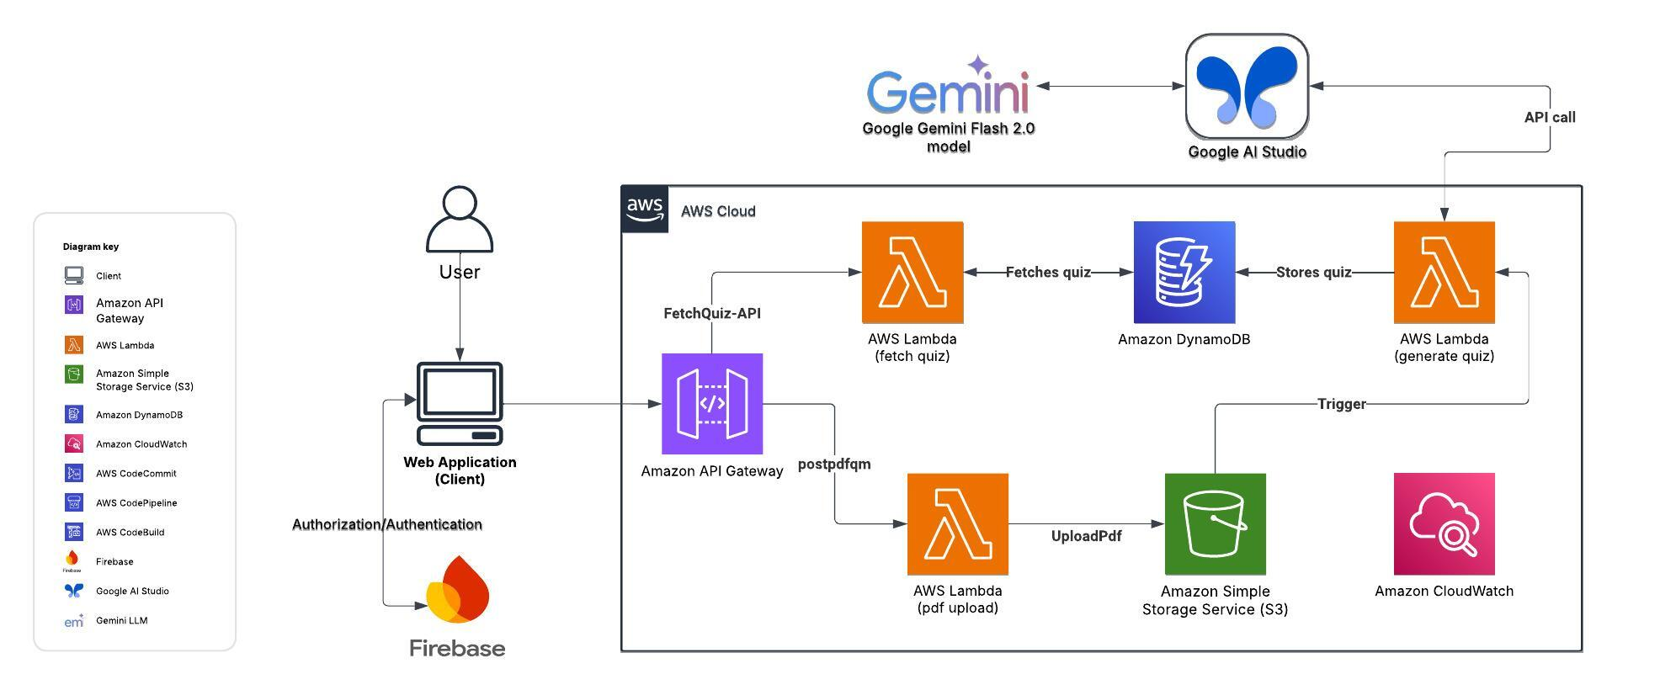
Architecture

Slide 7
